Slide 1
March 25th
Therapeutic approaches in MS: targeting inflammation.
Animal models of MS: Experimental Autoimmune Encephalomyelities EAE.
Use of animal models to understand the pathology.
Protein aggregation in MS?

Slide 2

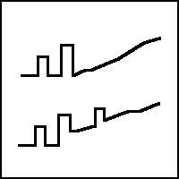
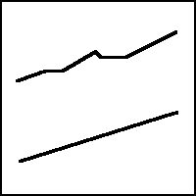

Clinical Forms of MS
Four internationally recognized general categories
Relapsing-remitting (RRMS): 55%
Clearly defined flare-ups & remissions; inflammatory lesions developing constantly
Early 20s & 30s; women 2:1
Initial disease activity in brain (cognitive)
Better prognosis: supporting equipment avg. 20 yrs
Majority of RRMS pts will develop SPMS (90% in 25-30 years)
Secondary Progressive (SPMS): 35%
Relapse frequency decreases but disability increases
Less remyelination & more plaques, resulting in steadily progressive disability with less recovery
Could represent different, advanced stage of RRMS
Primary Progressive (PPMS) 9%
At onset, steady worsening without relapses or remissions
Variations in rates of progression; occasional plateaus or temporary minor improvements
Late 30s/early 40s; men as likely as women
Initial disease activity in spinal cord (physical disability)
Worse prognosis: supporting equipment avg. 6-7 yrs
Progressive Relapsing (PRMS): 1%
From onset steadily worsening disease with clear acute relapses with or without recovery
Unlike RRMS, remission periods contain clinically observable continuing disease progression
P. Martini
Source: National Multiple Sclerosis Society & NIH estimates
Notes:
Familiar with these forms, graphs visually depict disease and disability progression over time – become more meaningful when you take a closer look
RR well defined acute attacks with full recovery, residual neurological deficit est over time – at this stage little or no progression between attacks
3. SP Relapses decline
4. PP we see progression PP progressively increasing disiability from the start w/o relapses,
5. SP a hybrid of these two disease forms (hence the two colors), pts exhibiting periods of intense symptoms, with only MINOR remission in between
Somewhat controversial, 1%

Slide 3
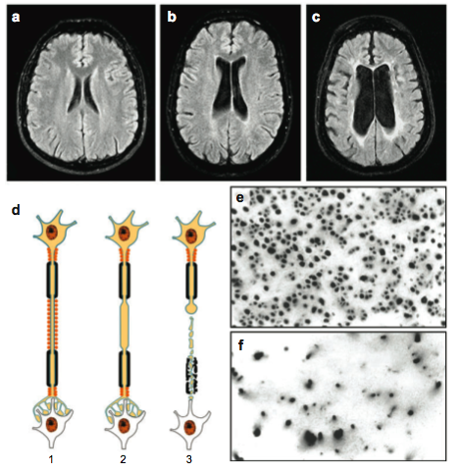
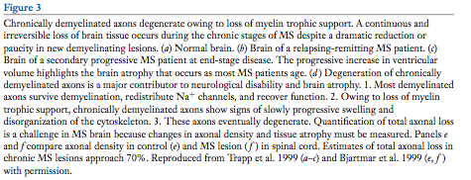
Degeneration of chronically demyelinated axons:
Loss of trophic support. SPMS.
HC
RRMS
SPMS
Axonal density

Slide 4
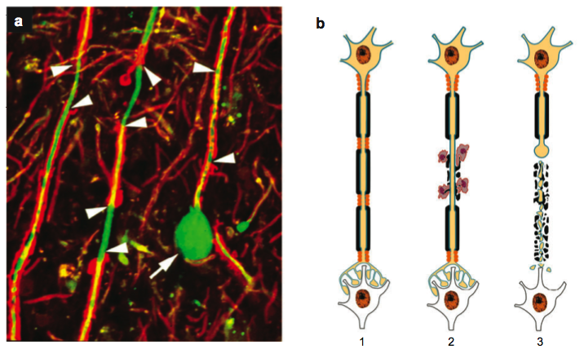
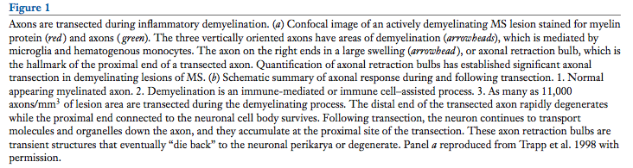
Axons are transected during inflammatory demyelination
Axonal retraction bulb
Proximity end of a retracted axon

Slide 5
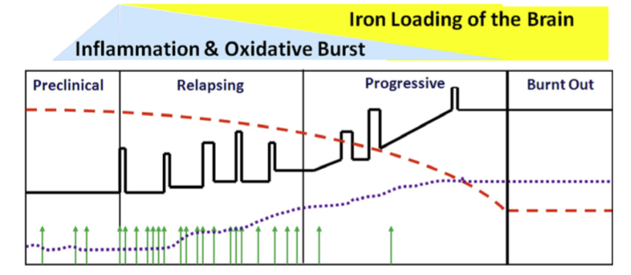
The pathology of MS changes with time
Brain atrophy
Brain Volume
Lesions
Lassmann and Horsen, 2011

Slide 6
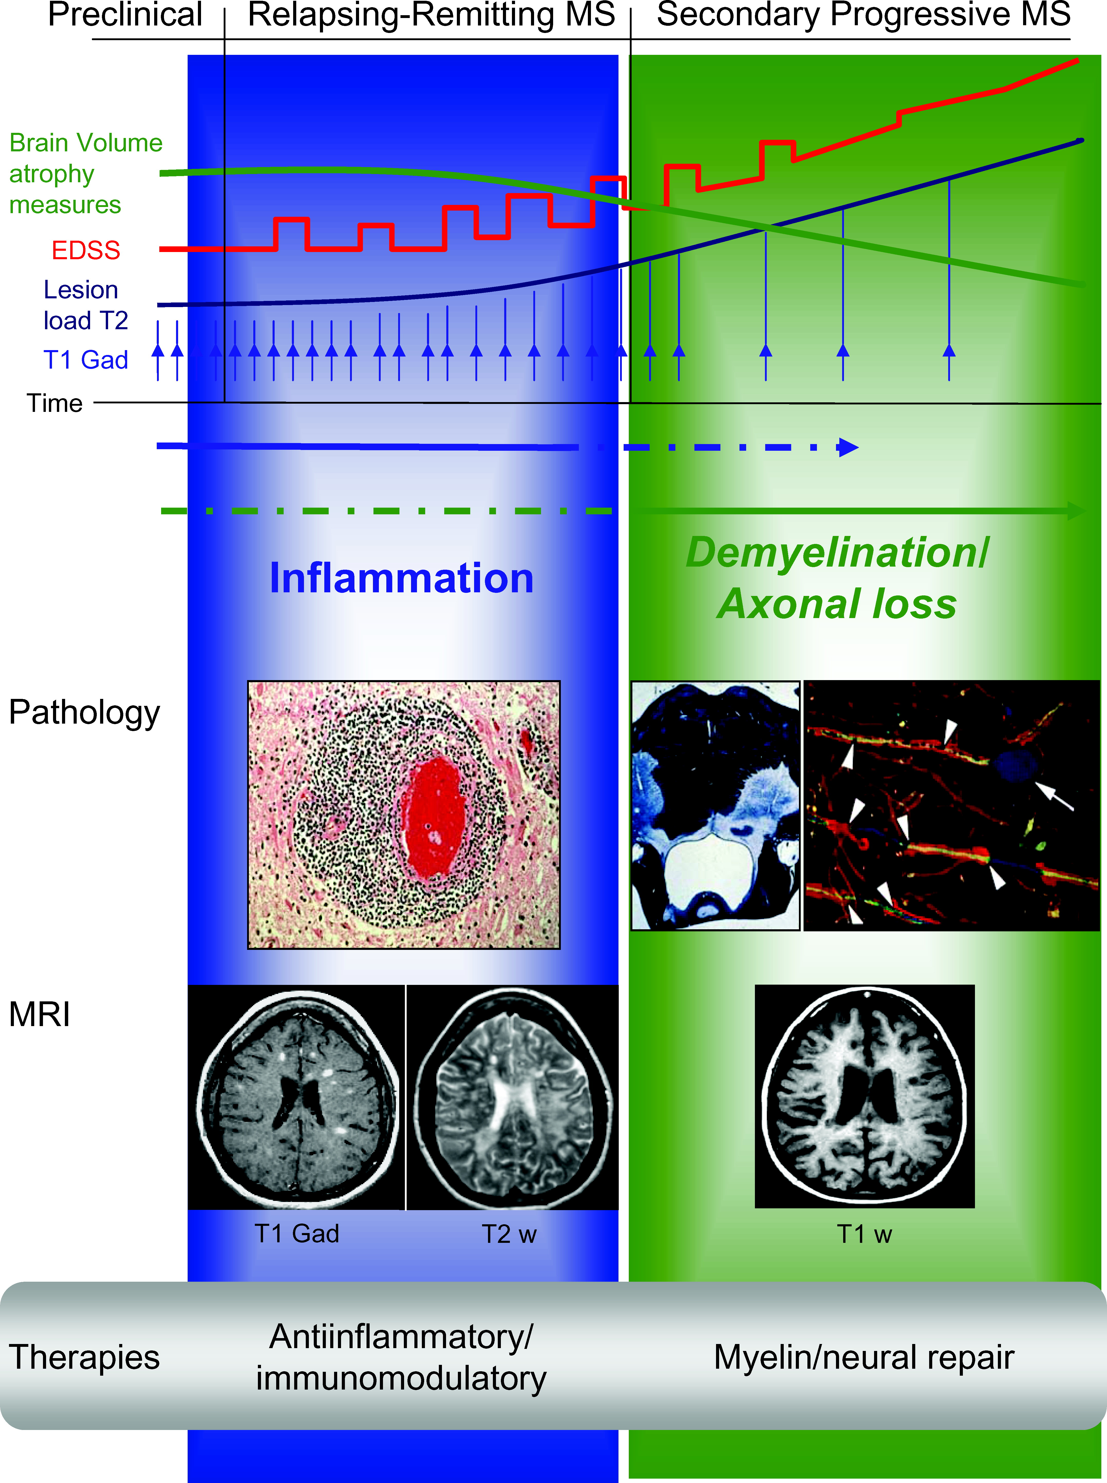
Relapsing MS and Progressive MS
These two classifications are critical to understanding the current & future treatment paradigms
Relapsing MS RRMS, worsening RRMS, SPMS with relapses
Progressive MS SPMS without relapses, PPMS
P. Martini
Sources: National Multiple Sclerosis Society; http://www.multsclerosis.org/progressiverelapsingmultiplesclerosis.html ; Sospedra et al., Annu. Rev. Immunol., 2005: (23) 683-747
Notes:
Some experts think that developing a single agent to treat both forms of MS is impossible, and that a more appropriate strategy is to target the inflammatiory/relapsing and degenerative /progressive components of the disesae.

Slide 7
Relapsing MS
Treatment Overview
Relapsing MS
FIRST-LINE
All approved for Relapsing MS
Disease modifying
Used as monotherapy
IFNβs
Glatiramer acetate
Monoclonal antibody
CONCURRENT THERAPY
Short-term, high-dose corticosteroid treatment
Standard through an acute relapse
Methylprednisolone
Prednisone
SECOND-LINE THERAPIES
First-line tx is not tolerated, non-responders, or worsening relapsing disease
Chemotherapeutics
P. Martini
Notes:
SWAP the efficacy in first line
55% of diagnosed pts treated, where a ~20% drop out of treatment (sometimes referred to as quitters)
Disease modifying =
Reduction in the frequency of attacks
Reduction in the number of of new lesions found on MRI scans, suggesting a decrease in myelin destruction

Slide 8
Progressive MS Treatment Overview
There are no therapies indicated to treat Progressive MS
Progressive MS
FIRST-LINE THERAPIES
Used as monotherapy
IFNβ
Glatirmamer acetate
Chemotherapeutic agents
CONCURRENT THERAPY
Short-term, high-dose corticosteroid treatment
Symptomatic treatment
Methylprednisolone
Prednisone
SECOND- & THIRD-LINE THERAPIES
Polytherapy given to pts who continue to deteriorate despite treatment with first-line therapies
Combinations include:
IFNβ + chemo agent
Glatiramer acetate + chemo agent
BMT & lymphoid irradiation (reserved for most dire cases)
P. Martini
Notes:
Start polytx quickly after mono first
In Progressive MS, inflammation is lessened; myelin, oligos, and nerve cells appear to just die off
Relapsing MS treatments are aimed at reducing inflammation and altering the function of attacking cell

Slide 9
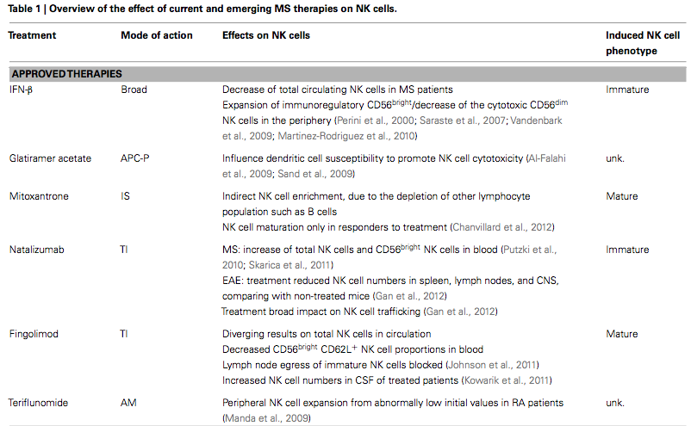
tysabri

Slide 10
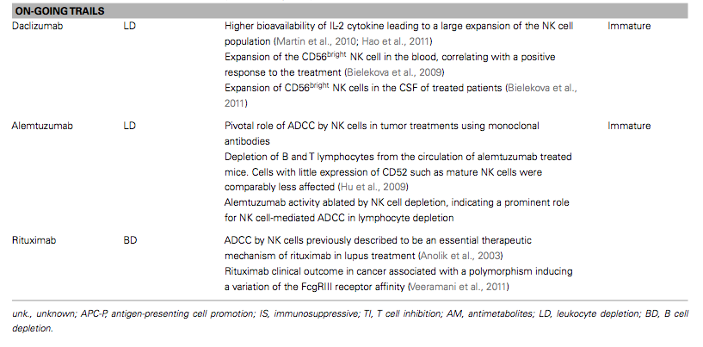

Slide 11
Avonex IFNb, IM
Betaseron IFNb- SC
Copaxone GA
Rebif IFNa- SC
Tysabri
Novantrone
Top Unmet Needs vs. Current Product Performance
Tysabri Ab against integrins
Reversing neuronal damage
Prevention of disease progression
Improved therapies for Progressive forms of MS
More convenient drug delivery
No current MS therapy addresses neuronal damage - Current therapies moderately effective in slowing disease progression - Relatively little therapeutic effect offered for Progressive MS - Inconvenient drug delivery (injectables, IV infusions)
P. Martini

Slide 12
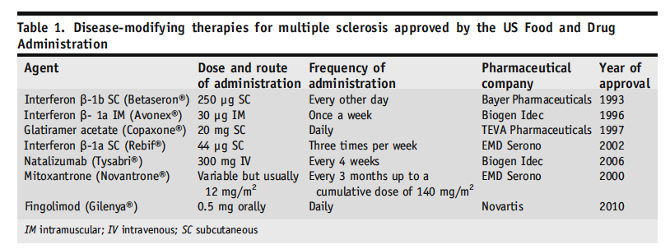
Therapeutic approaches in MS

Slide 13
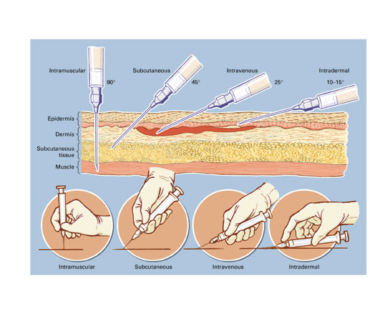
Delivery of MS drugs by injection
info.sanguinebio.com

Slide 14
Top Current Unmet Needs and Future Products
Unmet Need
Current tx
Future tx
Reversing neuronal damage
Prevention of disease progression
Improved therapies for Progressive forms of MS
More convenient drug delivery
- No advances likely to be made in addressing neuronal damage - Little to no advances will be made in slowing disease progression - Potential for improved therapies to treat Progressive MS - Mode of drug delivery likely to be significantly improved
P. Martini

Slide 15
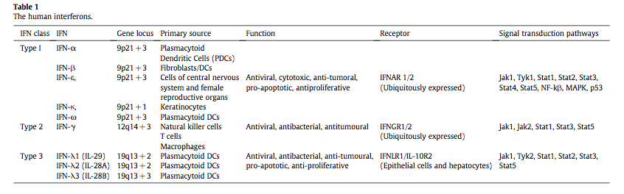
The Human Interferon

Slide 16
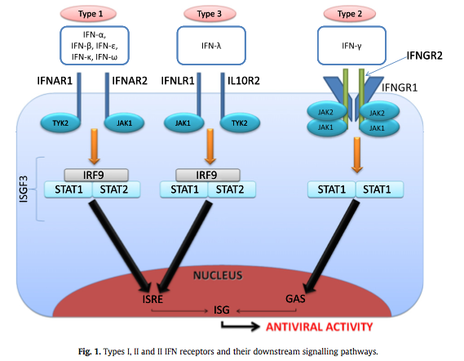
Signal transduction pathways activated by IFNs
ISRE: Interferon stimulate response

Slide 17
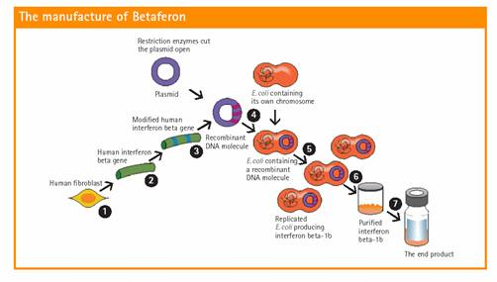
How IFNbeta is produced
http://www.ms-gateway.com

Slide 18
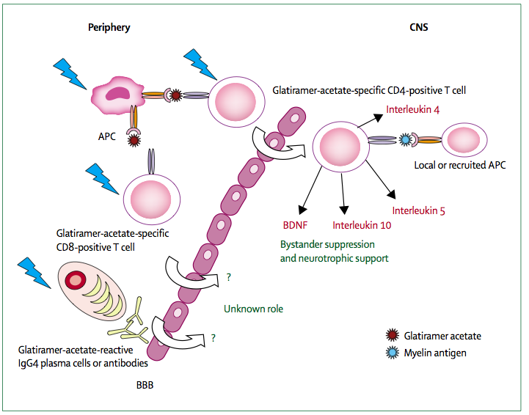
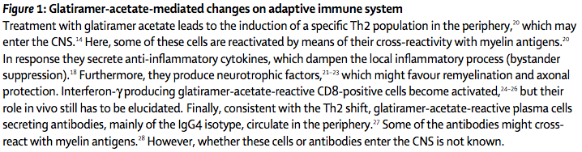
Glatiramer Acetate GA modifies the adaptive immune system

Slide 19
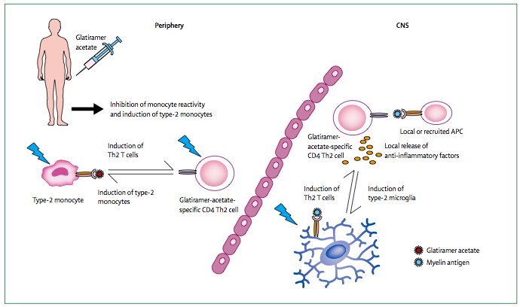
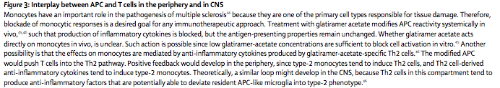
Interplay between Antigen Presenting Cells APC and T cells
Role of Glatiramer

Slide 20
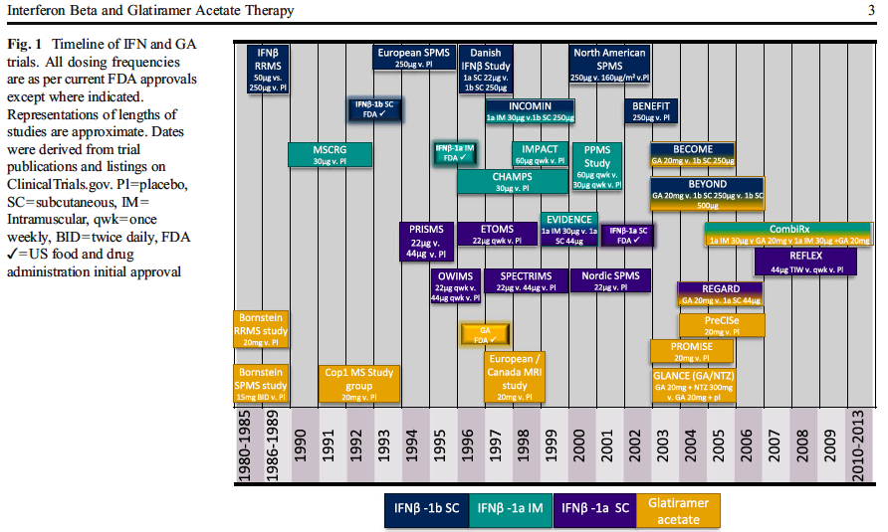
Timeline of IFN and GA trials

Slide 21
EAE ANIMAL MODEL (Experimental autoimmune encephalomyelitis)
Animals with EAE serve as animal models for MS.
EAE is NOT a single disease in a single species.
It’s INDUCED by injecting specific myelin proteins in combination with an immune-exciting agent (adjuvant).
It’s a disease of the BRAIN and SPINAL CORD.
Like MS, it’s an INFLAMMATORY DEMYELINATING AUTOIMMUNE disease.
Like MS, it takes several clinical forms, including RELAPSING-REMITTING and CHRONIC-PROGRESSIVE.
BENEFITS:
Identifying sites in the CNS more likely to develop MS lesion (plaques).
Finding out which immune cells are involved and how they interact.
Developing experimental treatments.
DISADVANTAGES:
EAE is NOT multiple sclerosis; failure of some assumptions.
P. Martini

Slide 22
EAE IN MICE: MIMICKING HUMAN CLINICAL COURSE OF MS
Induction phase
Effector phase
MOG35-55-induced in C57BL/6
5
3
2,5
2
4
1,5
1
0,5
3
0
1
5
10
15
20
25
30
35
40
45
50
55
60
Mean clinical score
PLP139-151-induced in SJL
2
Induction phase
Effector phase
3
2,5
1
2
1,5
0
1
0,5
0
1
6
11
16
21
26
31
36
41
46
51
56
61
66
71
76
= clinical relapse
81
86
91
96
Days post-immunization (p.i.)
P. Martini

Slide 23
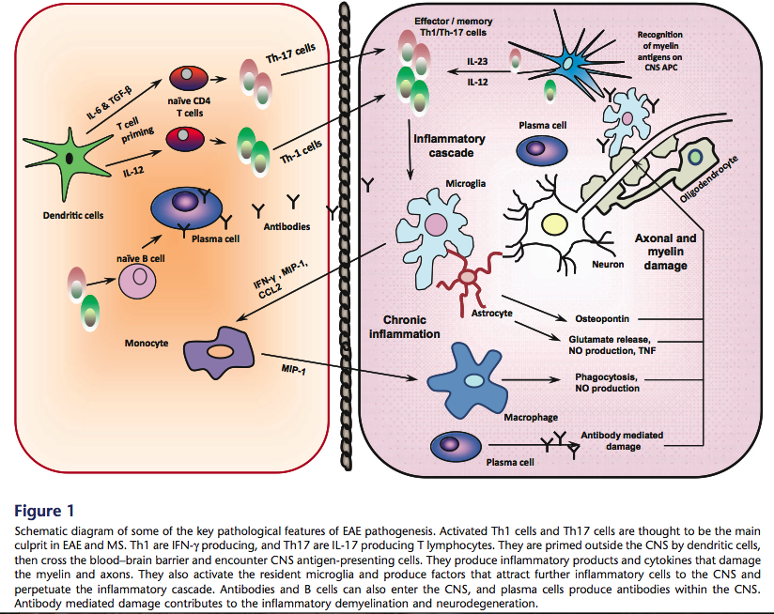
Key Pathological Features of EAE pathogenesis

Slide 24
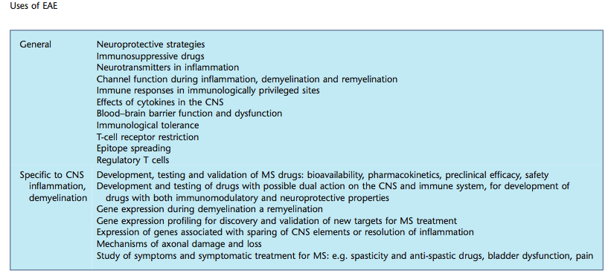
Uses of EAE

Slide 25
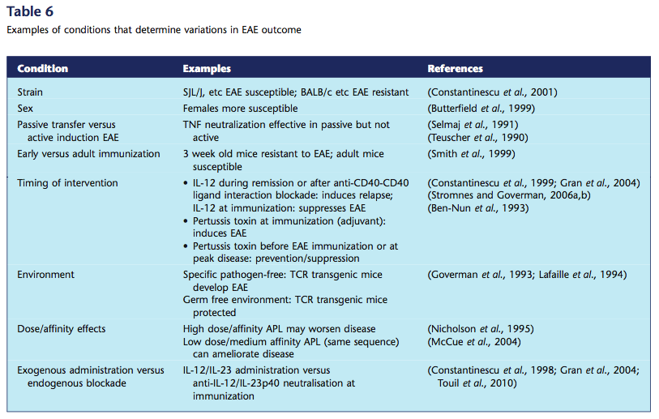
Conditions that determine variations in EAE outcome

Slide 26
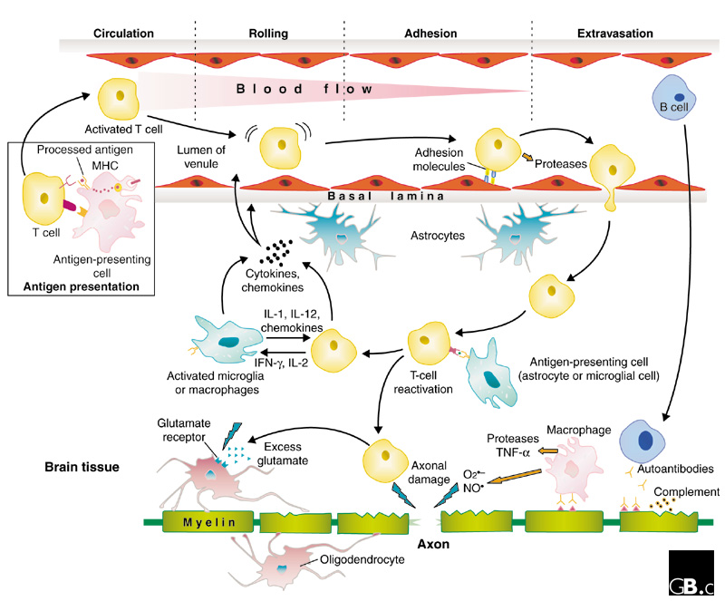
Pathophysiology in MS
Th1 cytokines:
Proinlfammatory
Th2 Cytokines
Antiinflammatory
Receptors for ILs are found also in glial cells
And oligodendrocytes
Pro-inflammatory cytokines can be toxic by cytotoxicity or by inducing antibody production
P. Martini
Baranzini S.E. et al, Genome Biology 2002: 3(10) 1027.1-1027.5

Slide 27
-IL-4 and IL-10 are Th2 type cytokines, blocking inflammation either by directly interfering with pro-inflammatory cytokines or indirectly inhibiting their production.
-In addition, IL-4 and IL-10 receptors can be up-regulated in MS
What happens in absence of IL-4 mediated signaling in a IL-4Rα KO mouse model?

Slide 28
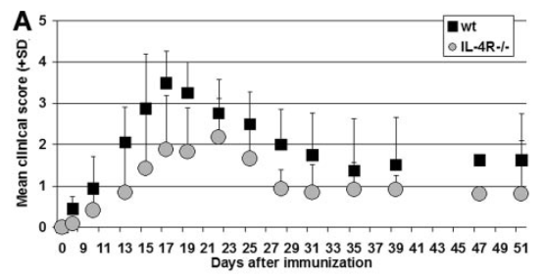
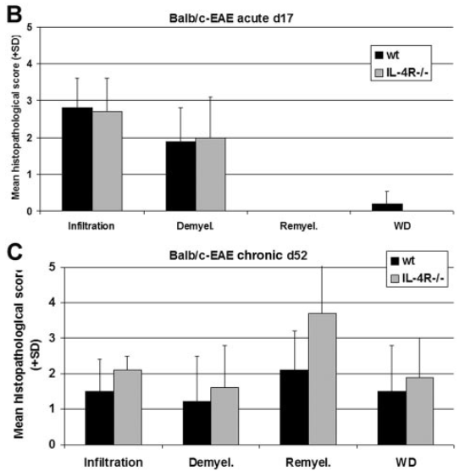
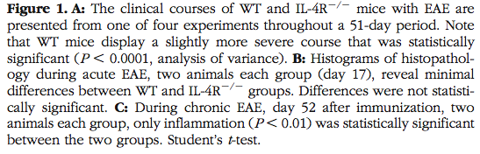
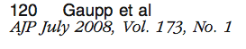
IL-4Rα KO protects from MS symptoms, also associated with remyelination in the chronic phase
A long term effect?

Slide 29
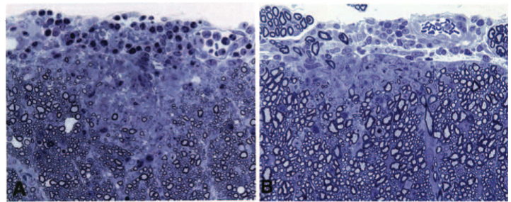
IL-4Rα KO protects from neutrophil infiltration
(a phenomenon associated with inflammation)
WT
IL-4Rα-KO
Neutrophils (inflammation)
d17
myelin

Slide 30
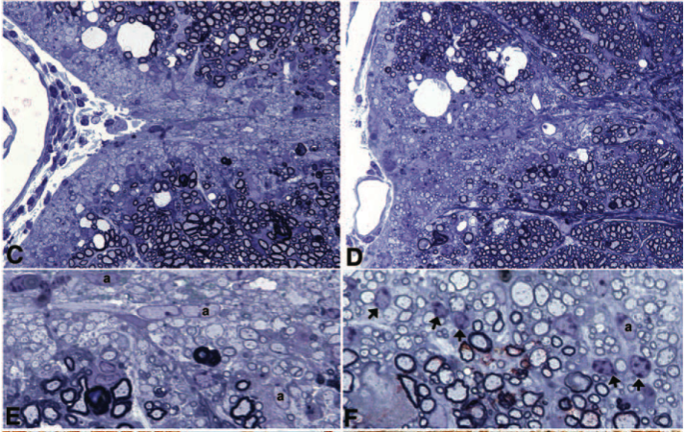
IL-4Rα KO favors remyelination in the chronic disease
WT
IL-4Rα-KO
d52
Arrows:
Olygodendrocytes
Remyelination
Naked axons

Slide 31
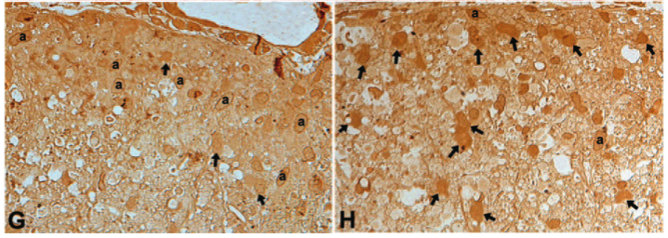
Oligodendrocytes are increased in IL-4Rα KO
WT
IL-4Rα-KO
d52

Slide 32
IL-4Rα KO ameliorates remyelination probably by promoting the survival of oligodendrocytes

Slide 33
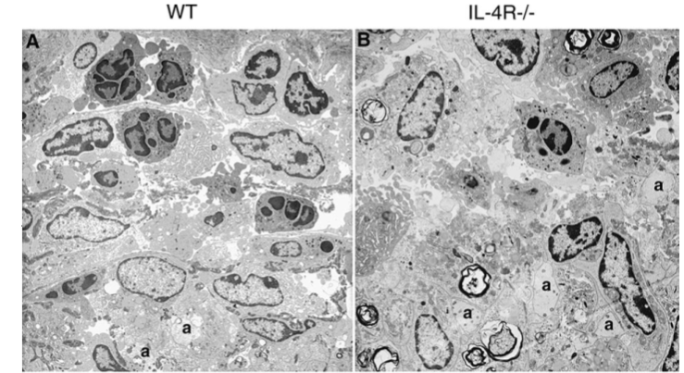
Neutrophil invasion and remyelination in the acute or chronic phase: EM
neutrophils
d17
Demyelinated axons

Slide 34
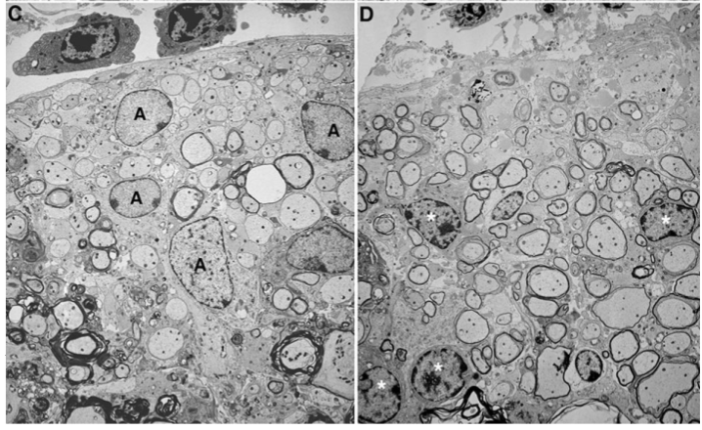
Obvious remyelination in the chronic phase in IL-4Rα KO
WT
IL-4Rα-KO
astrocytes
d52
oligodendrocytes

Slide 35
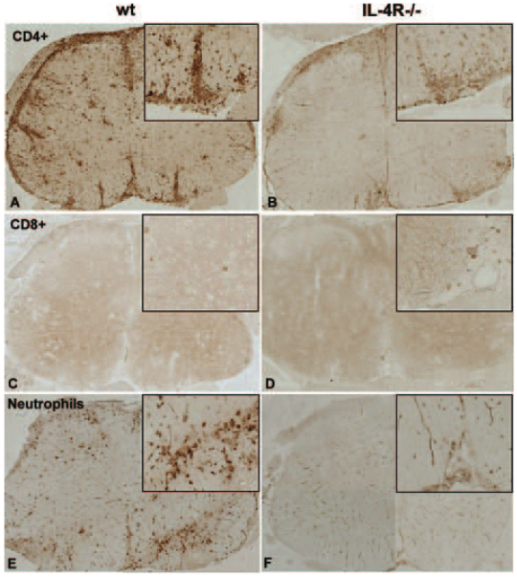
Decreased activated T cell in IL-4Rα KO
Protective because of inhibiting inflammation?

Slide 36
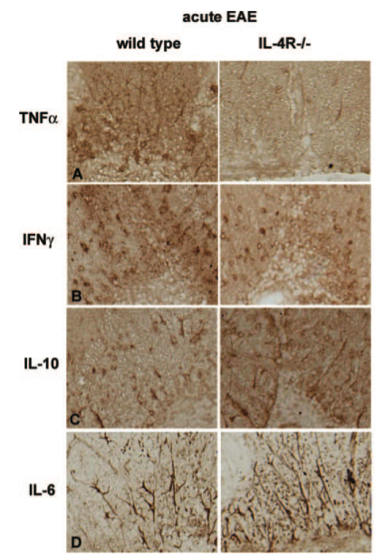
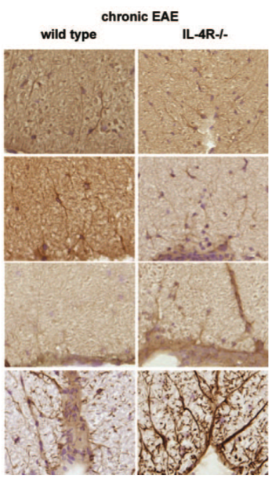
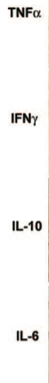
Expression of cytokines changes during the different phases of the disease

Slide 37
KO animal in the CHRONIC PHASE:
1-Increased antiinflammatory response
2- Increased Olygodendrocytes proliferation and migration
COMPENSATORY GENE REGULATION?

Slide 38
Protein aggregation in MS?
Fibronectin can form aggregates in MS lesions altering oligodendrocytes differentiation, therefore inhibiting remyelination.

Slide 39
FACTS:
1-Migration and differentiation of immature oligodendrocytes to lesion sites is impaired in MS.
2-Extra cellular matrix proteins may affect oligodendrocytes growth and function.
3-Fibronectin promotes proliferation but reduces myelin production.
Aberrant changes in the extracellular matrix that affect oligodendrocytes ultimately reducing myelination in MS?
FIBRONECTIN?????

Slide 40
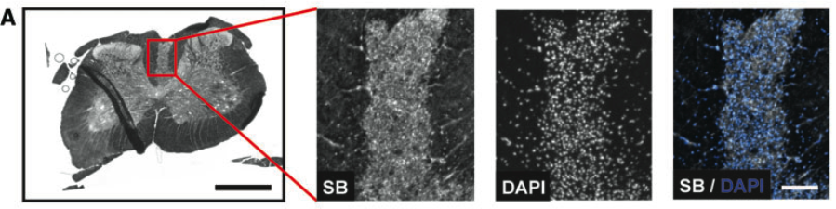
Characterization of an animal model of demyelination
Sudan Black to stain for myelin
Lysolecitin induces demyelination lesions that are followed by remyelination, and are without axonal loss.

Slide 41
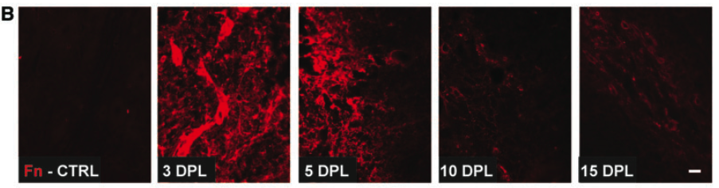
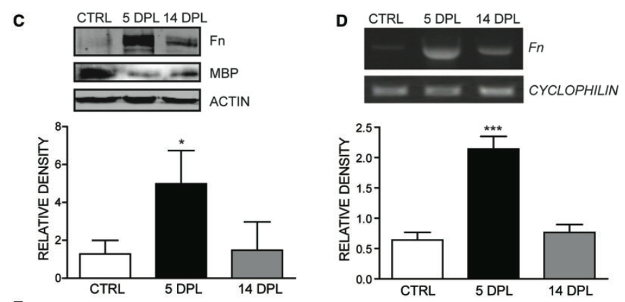
Fibronectin accumulates in the acute phase of demyelination

Slide 42
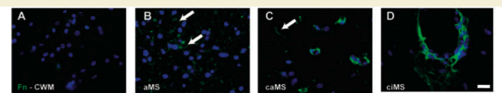
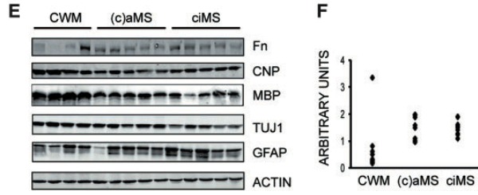
In a model of EAE, Fibronectin accumulates during both active and inactive phases of the disease…
Chronic relapsing EAE

Slide 43
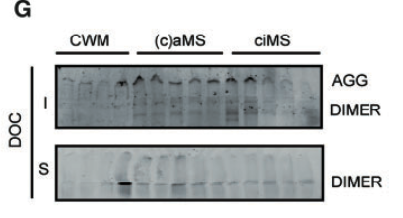
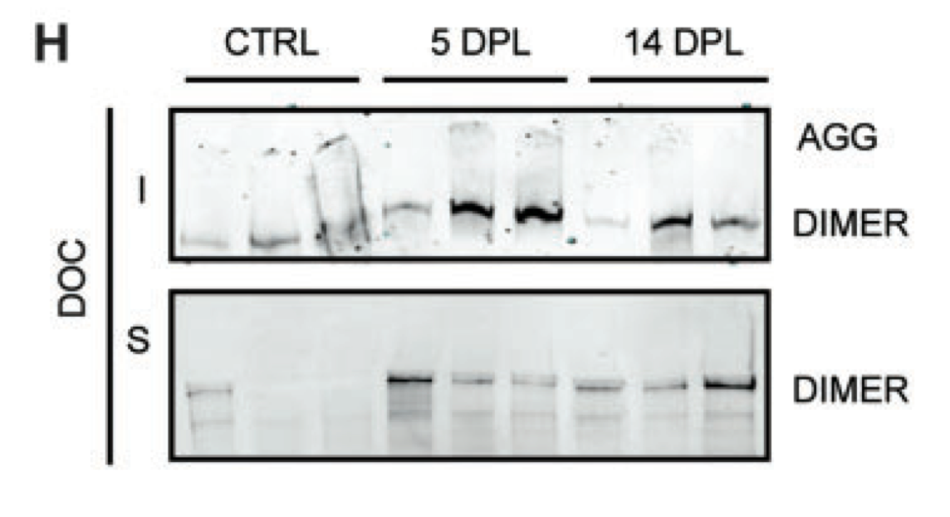
…and forms aggregates
not found in toxin-induced demyelination

Slide 44
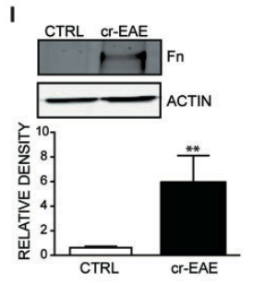
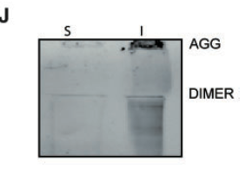
…that are insoluble….

Slide 45
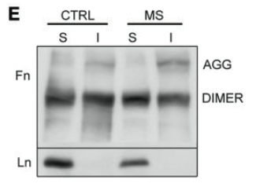
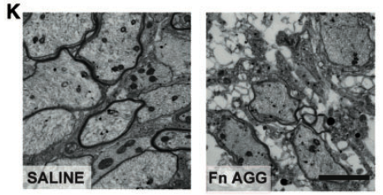
Remyelination is impaired in spinal cords injected with fibronectin aggregates

Slide 46
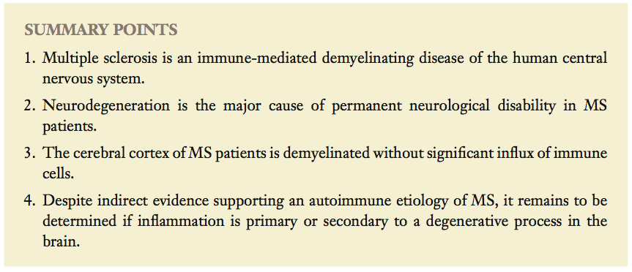

Slide 47
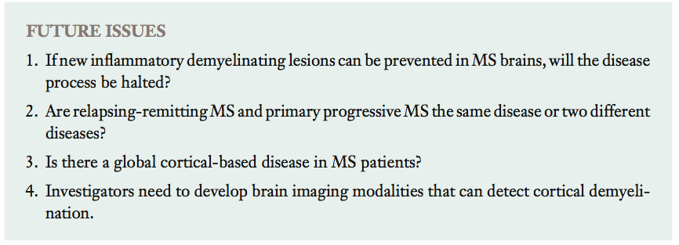

Slide 48
http://www.youtube.com/watch?v=LtUvqhsQlR0

